Slide 1
Cloud Native Operations (Kubernetes, Service Mesh and Workload Engine) FY22 Q3 CISG-SEVT March 15, 2022

Slide 2
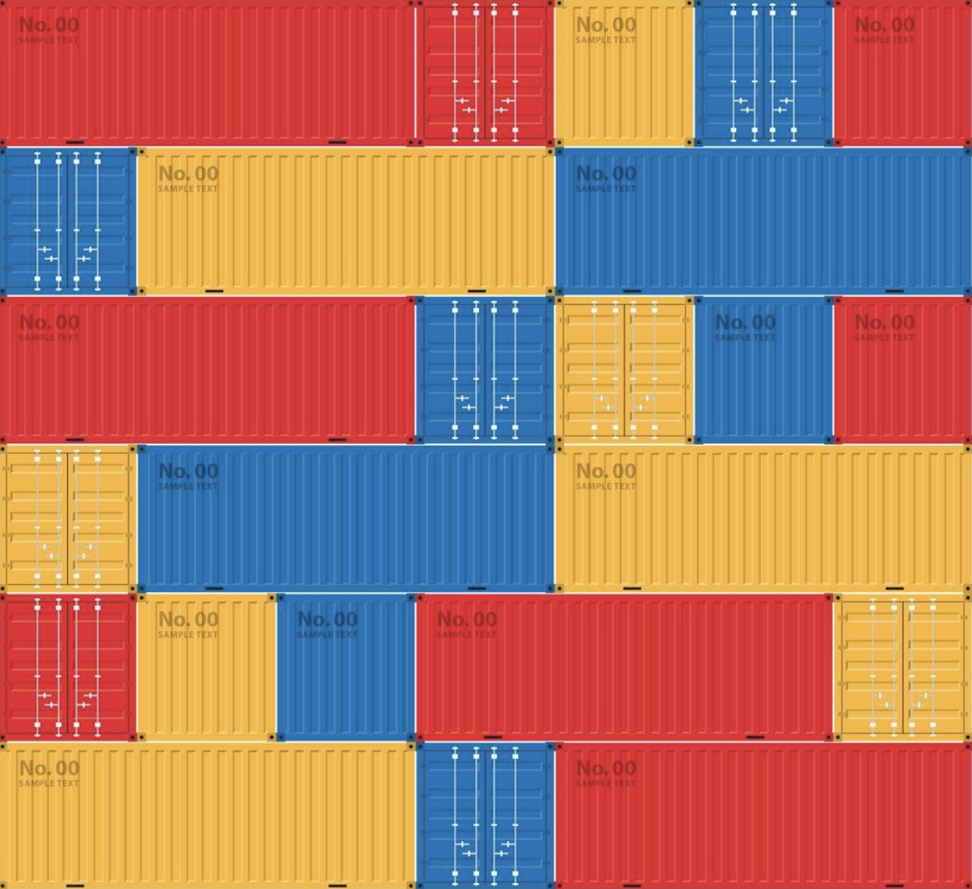

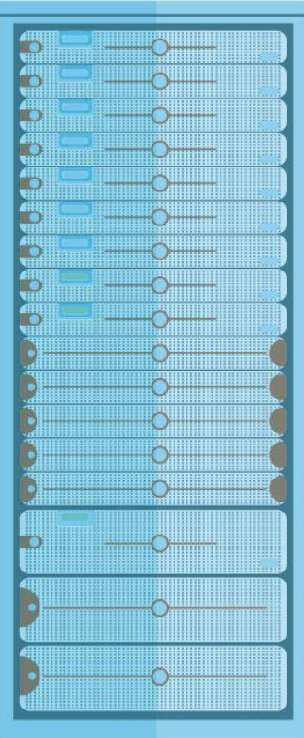


The Transformation to Cloud Native
VM
VM
VM
VM
App architectures are changing
Monolithic to composable
Infra architectures are changing
Ops, Org architectures changing
VM
VM
VM
VM

Slide 3






API-First Cloud Native Journey
Developer
Edge Application
Front-end APIs
SaaS APIs
Back-end APIs
Data
Operations
Hybrid Operations & Full Stack Observability
Discoverability
Connectivity
Consistency
API Driven, Security, Identity
Code, to deploy, to runtime
Real-time governance & compliance

Slide 4
















Operations Complexity of Managing Multiple-Domains
Unified Policy Control & Governance
Automation, Orchestration and Optimization
Multi-Cluster Deployments & Management
LOBs
IT Ops
DevOps
Hypervisors and Virtual Machines
Physical Infrastructure
Private
Public

Slide 5
Our Kubernetes Strategy
A SaaS experience, life-cycle managed stack for multi-cloud and multi-cluster Kubernetes with observability for modern Cloud Native applications
Create prescriptive Cloud Native Solutions focused on outcomes (i.e. financial, health&science, retail)
Enable fleet management (HW, VMs, Clusters) globally (Edge to Public Cloud) at scale
Solve multi-cloud and multi-cluster Kubernetes complexities focusing on multi-tenant, multi-cluster observability, namespaces and identity
Offer top to bottom (App to HW) solutions that can be attached to any K8s distros delivered as add-ons via Intersight
HOW

Slide 6




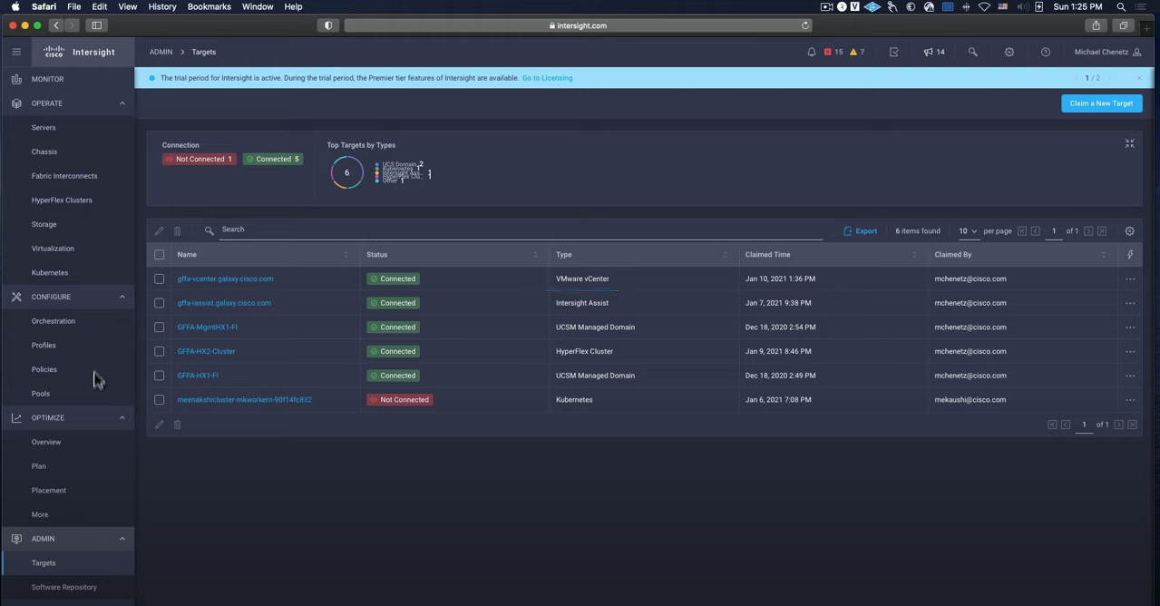



Intersight Kubernetes Services (IKS) Solving multi-cloud & multi-cluster Kubernetes
$1.4B
85%
#2
Global container management revenue by 2025, with a CAGR of 25.2%
Of large enterprises will adopt containers for cloud native applications by 2025
Top challenge for customers deploying containers is operational complexity, second only to “lack of skills”
Dev
Ops
Data center
Deploy:
SaaS deployed to on-premises
full-stack & life-cycle managed
consistent policy and controls
secured and curated images
Attach:
global fleet management
integrated with IWO
simplify operations
consistent policy and control
Colo
Intersight Kubernetes Service
Edge
Source: Gartner document: G00766101 and G00737153

Slide 7

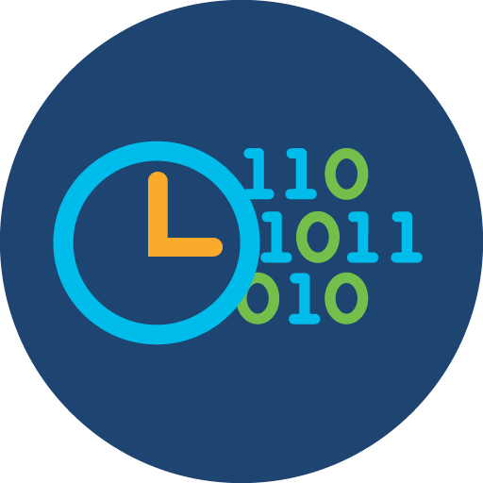








Service Mesh Manager (Traffic Management, Security and Observability
Service Mesh Manager
(life-cycle managed by Intersight)
Data center
Dashboard & Topology view
Observability
Colo
Edge
Traffic
Management
Security
Service Level Definition:
Define, measure and alert for matching SLOs
URL Rewrite:
Create new URL’s for the same service by re-writing the URL in the service mesh
Tracing:
Real time traffic tap with filtering and detailed metadata
L7 Traffic Routing:
Do functional testing on a subset of users in production before go-live
Security with mutualTLS:
Ensures traffic encryption independent of app language
Canary Deployments:
Gradually increase traffic with new releases and easily rollback if needed
Notes:
Presenter:
Describe the different deployments on-prem and cloud.

Slide 8
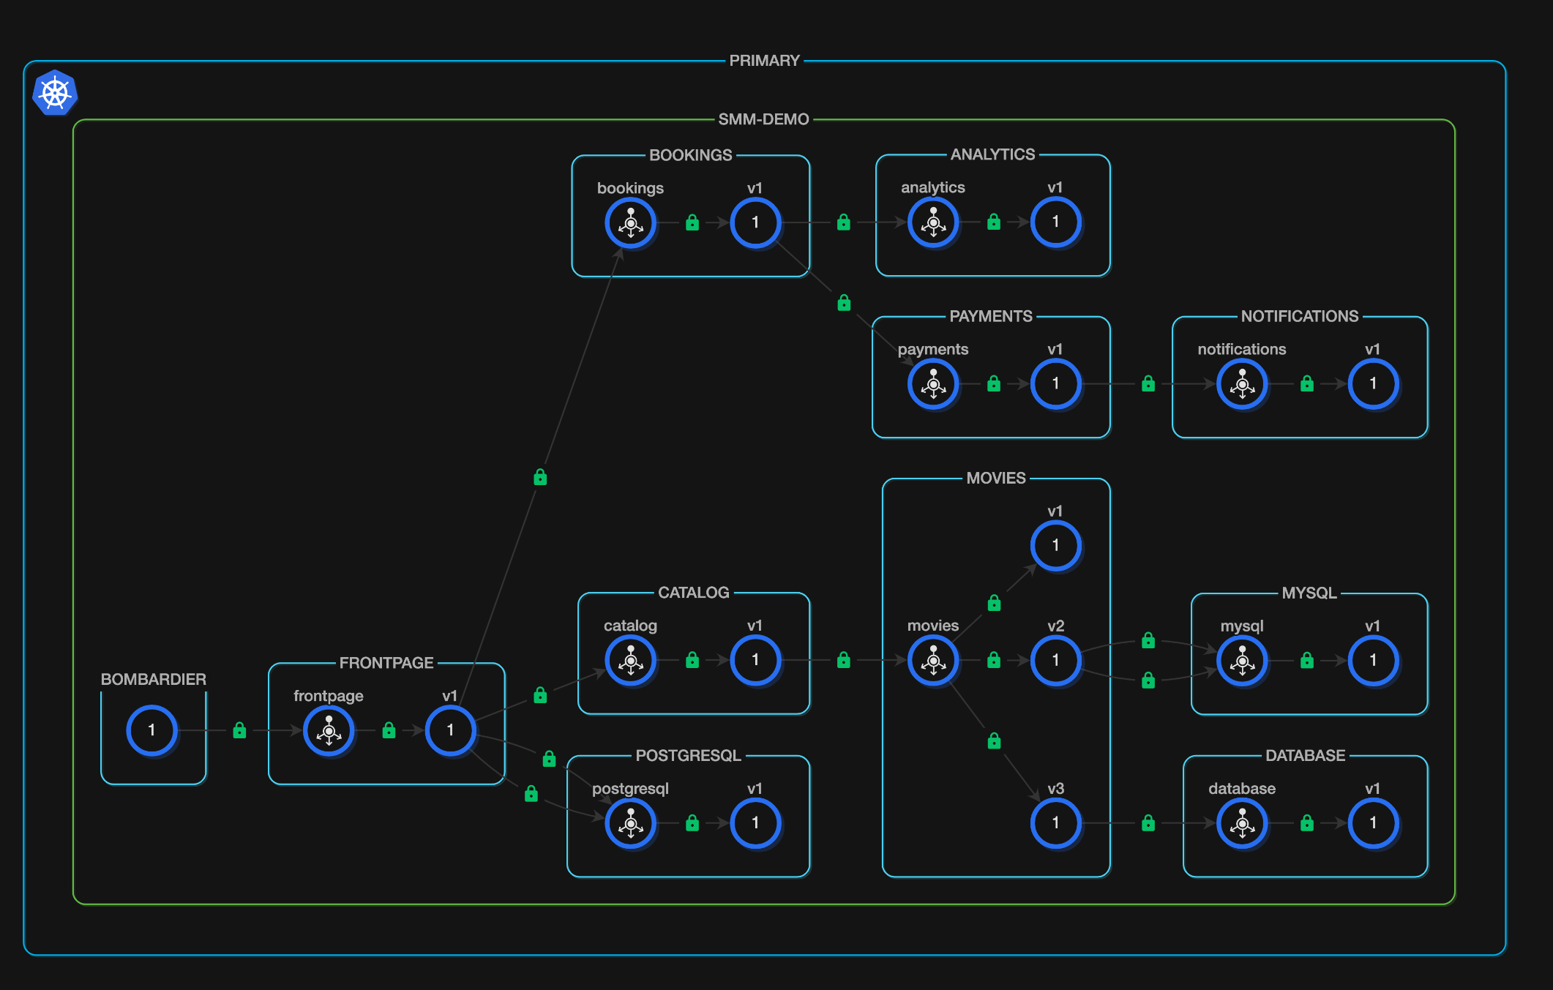
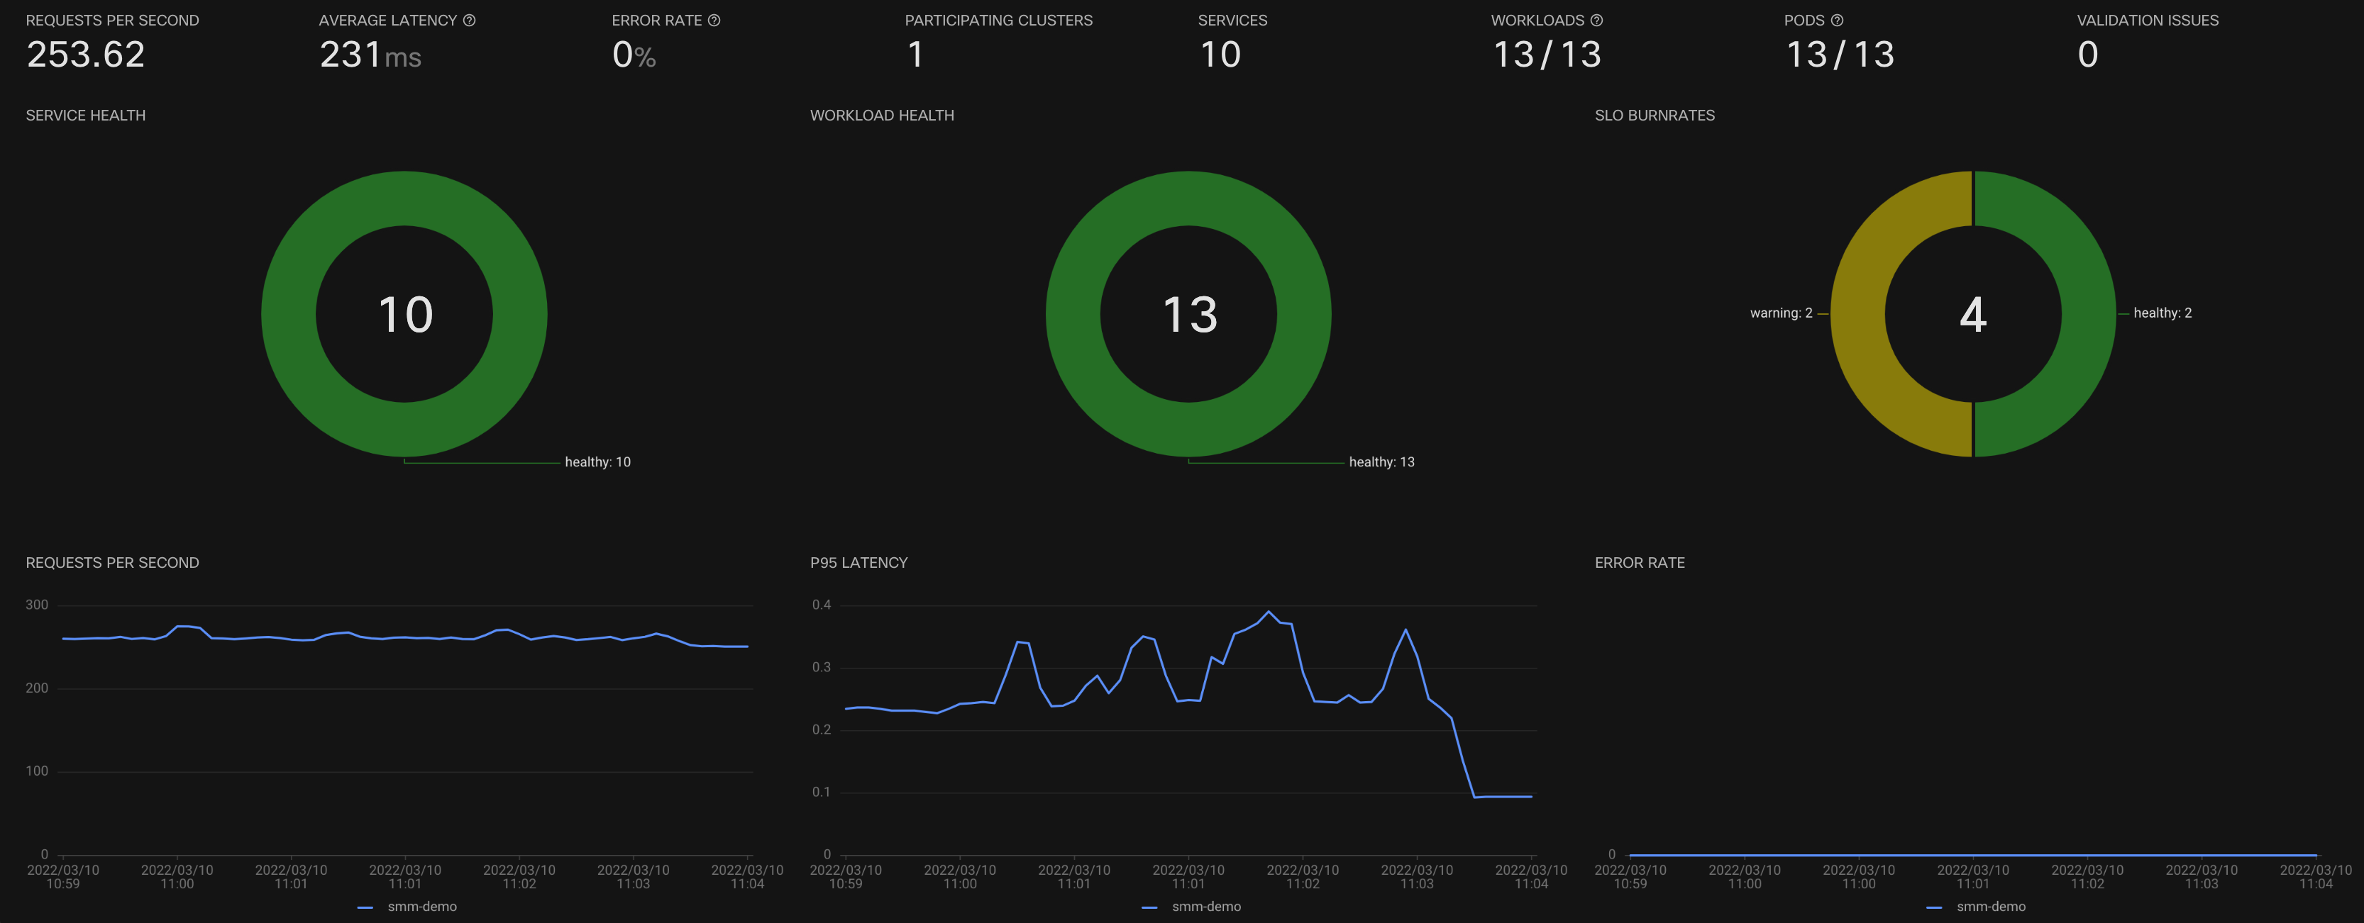
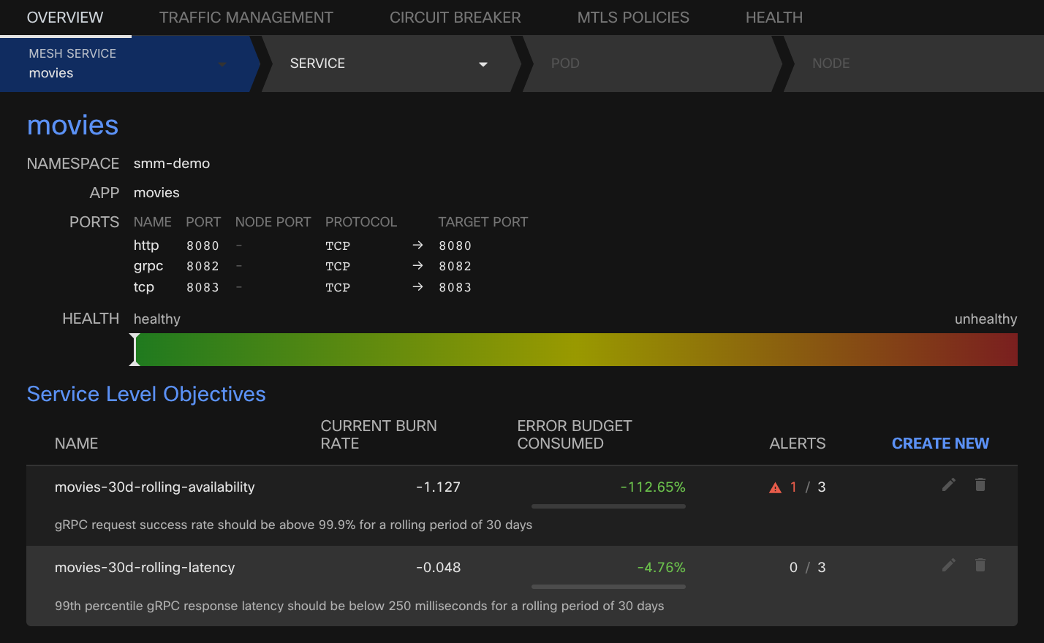
Multi-cluster & Multi-cloud Service Mesh
Topology View
Overview of Service & Workload Health
Service Level Objectives
Traffic Management

Slide 9

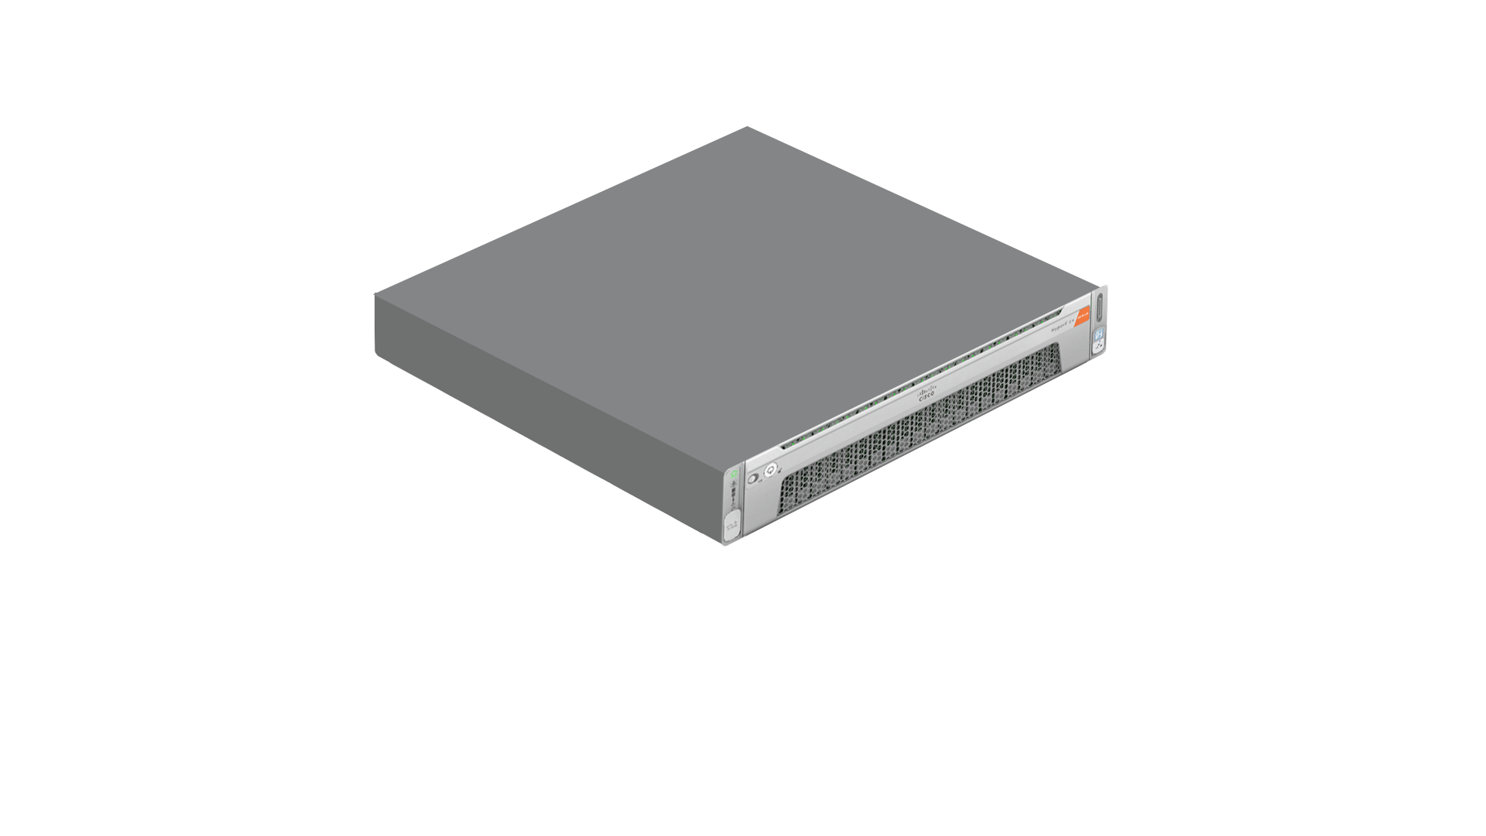
Cisco Intersight Workload Engine
Next-gen architecture for modern, cloud native workloads
Clustered, enterprise-grade, container native platform
Built from the ground up by Cisco including hypervisor, clustering, storage and integrated SaaS management
Workload Management
Cluster Management
Built from the ground up for HyperFlex Hyperconverged architecture integrated with HyperFlex. Supports Containers on VMs, bare metal & serverless in one platform
IWE Hyperconverged Cluster OS
Server Management
Simple and seamless management Manage private cloud lifecycle with one tool upgrades, capacity expansion, repair & security
Simplified cloud operations with unified management
Modern platform for containers and serverless
Enterprise-grade performance and availability

Slide 10
IKS Roadmap (key items)
Q1CY2022
Q2CY2022
Q3CY2022
Service Mesh Manager (available)
IKS on Workload Engine (available)
K8s 1.20 & 1.21
ContainerD
IKS Private Appliance
Public Cloud Attached Clusters
K8s OIDC Provider Support
K8s 1.22 & 1.23
GPU Enabled Clusters (Passthrough)
SMM Multi-cluster
Helm CD Operator
IKS on Bare Metal
vGPU Enabled Cluster

Slide 11
IWE Roadmap
Q1CY2022
Q2CY2022
Hardware/Form Factor HX M5 Hybrid UCS M6
Lifecycle management: Foundation for Automated software upgrade
Storage: HXDP 5.0
Operations: Enhanced password management cluster config changes
Hardware/Form Factor
Expansion with compute-only nodes (HX M5, UCS M6)
Nvidia GPU passthrough from IWE to IKS VMs
Lifecycle management: Automated upgrade
Maintenance mode for compute-only nodes
Automated replace compute-only/converged nodes
Intersight Appliance based IWE
Operations: Enhanced health checks
Configurable and enhanced alerting for nodes/cluster/VM
IKS-on-IWE Add-on parity with IKS-on-ESXi

Slide 12
Target End of Q3
Offer | IKS Freemium (no PID required)* Non-Production | IKS Advantage (90 days trials)
SaaS Meter/Price | Limit to 10 nodes (nodes) IKS clusters limited to 1 control and 4 workers | DC-MGT-SAAS-KS-AD (vCPU) DC-MGT-SAAS-KS-AD2(Node)*
PVA Meter/Price | N/A | DC-MGT-PVA-KS-AD (vCPU) - TBD
Infra Providers | VMware (ESXi) – BYO Cisco Virtualized (IWE), HXDP licensed separately Bare Metal (limited to 1 control and 4 worker nodes) | VMware (ESXi) – BYO Cisco Virtualized (IWE), HXDP licensed separately Bare Metal (limited to 1 control and 4 worker) *
IKS Add-on’s | Essentials CNI (Calico) CSI (vSphere or HX) Cert Manager L7 Load-balancer (NGNIX) L4 Load-balancer (Metal LB) | Essentials + Production Add-ons Helm Continuous Delivery* Registry (Harbor)* Monitoring (Prometheus / Grafana) Kubernetes Dashboard
Attached Clusters | Limited to 1 attached cluster | Included (no limit)
Service Mesh Manager | Included with each IKS node | Included with each IKS node
Persistent Storage | VMware vSphere – BYO HXDP (licensed separately for IWE) | VMware vSphere – BYO HXDP (licensed separately for IWE)
IMM Requirement | Not required for VMware | Not required for VMware IIS for IWE/IKS-BM
Support | Community (https://community.cisco.com/) | TAC Support
Inactivity Limits | After 90 days (attempt to notify of inactivity). If, no response clusters/nodes may be automatically deleted | N/A
Target
Target

Slide 14

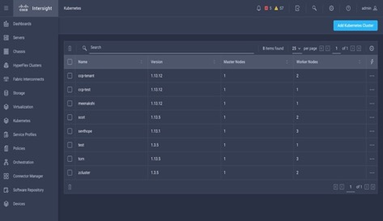


Cisco Intersight Kubernetes Service Operationalize production-grade K8s with a turn-key, flexible platform
Native Kubernetes – 100% Upstream
Production Grade: hardened, secure, robust
Validated Out-of-the-box Container Interfaces
Networking | Storage | Load balancing
…
Curated Add-ons (open source and 3rd-party)
Logging | Monitoring | Registry | Service Mesh
Simplify Kubernetes day 0 to day N operations anywhere
More value with multiple options (hypervisors, storage and bare metal)
Reduce risk and cost with a security-hardened, highly-available platform
Notes:
IKS is a SaaS-delivered, turn-key container management platform for multicloud, consistent production-grade Kubernetes. It:
runs on ANY infrastructure as a lightweight self-hosted software. Optimized for Cisco HX and UCS, deployed on top of VMware vSphere, with bare metal options coming soon
automates the installation, deployment and lifecycle management (OS updates/Kubernetes updates) of 100% upstream self-service K8s clusters via an easy-to-use simple user interface
includes all the necessary networking (CNI, ACI CNI, Istio service mesh), persistent storage (CSI), logging (EKF), monitoring (Prometheus/Grafana), L4/L7 load balancing and registry tooling, RBAC configuration
integrates with AWS, Azure, and Google Cloud (coming soon)
is built for the enterprise with hardened security and enhanced availability features like multi-master nodes and self-healing
optimized for AI/ML workloads with multi-GPU support
Beyond just offering a KaaS capability, IKS natively integrates with the other Cisco Intersight services to offer (as of GA 4/2/21):
IKS + IST (Intersight Service for HashiCorp Terraform) Integrate IaC w/on-prem for IKS cluster and application management
IKS + IWO (Intersight Workload Optimizer) AIOps driven right-sizing of IKS K8s apps/infra based on historical and percentile utilization of CPU and memory. Intelligent top down K8s apps and cluster auto-scaling.

Slide 15

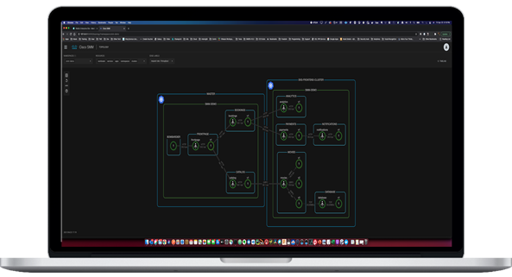
Service Mesh Manager
Modern application networking for the cloud native era
Operationalize the service mesh
Multi-cluster observability
Simplified service mesh management
Policy-based app networking & security
Introducing extensions for Intersight Kubernetes Service
Notes:
We are also introducing extensions for Intersight Kubernetes Service, with the first one coming from the recent acquisition of Banzai Cloud
The Cisco Service Mesh Manager (previous name Banzai Backyards) simplified the deployment of Istio service mesh and provides an advanced dashboard, deep visualization, tracing capabilities and easy management for networking between container-based apps and policy-based security

